Slide 1

Increase the mall's profitability through appropriate marketing strategies and pricing

Slide 2

Abstract—Statement of problem
1. The mall lacks effective marketing strategies that align with its target market and overall business goals. There is a need to assess the current marketing efforts and identify areas of improvement.
2. There might be a mismatch between the perceived value of the products or services and their pricing. Additionally, the pricing strategies need to consider market dynamics, competitive landscape, and customer preferences. It is essential to evaluate and refine the pricing approach to ensure optimal profitability without compromising customer satisfaction.

Slide 3
Abstract—Business questions
Optimal marketing campaign targeting
2. Product pricing and positioning
Notes:
1.By analyzing the customer data and their spending scores, businesses can identify the target audience with the highest potential for response to marketing campaigns.
This can help optimize marketing efforts and allocate resources effectively.
2.The data on annual income and spending score can provide insights into customer preferences and price sensitivity.
This information can be used to determine optimal pricing strategies and position products to attract target customers.

Slide 4
Introduction
In the ever-evolving retail industry, malls are constantly seeking ways to increase profitability and stay ahead of the competition.
Two critical factors that play a significant role in achieving this goal are implementing appropriate marketing strategies and optimizing pricing tactics. By leveraging these strategies effectively, malls can attract more footfall, increase sales, and ultimately enhance profitability.

Slide 5
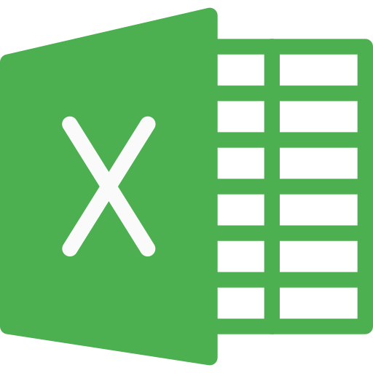

Methodology
Using Excel and Python to analyze which range of age and annual income is mall main target for the next season.
Focus on using histogram plots, box plots, clustering by k-means to describe data.

Slide 6

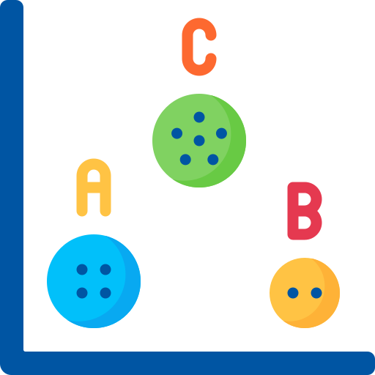

Methodology
After checking for missing values and converting gender to numerical values, analysis using histogram plots, box plots, clustering by k-means.

Slide 7
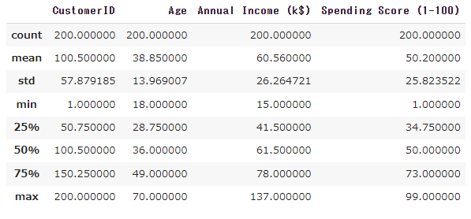
Techniques of Descriptive Analytics
In order to overview into our data and analyze the insights we looked at the following descriptive statistics about customers.
​

Slide 8
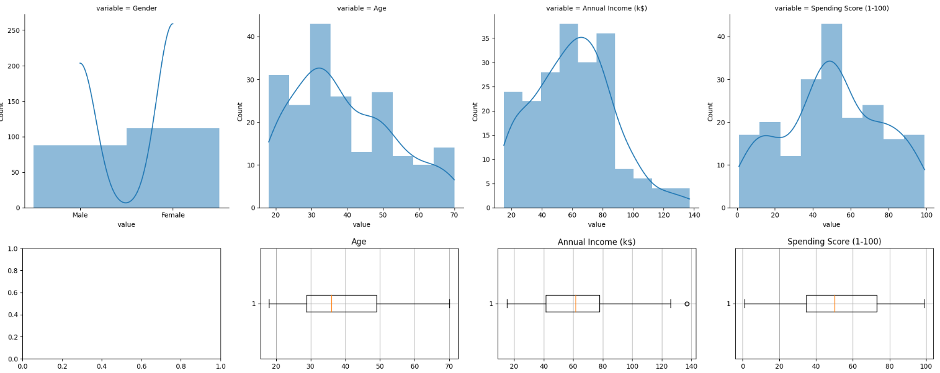
EDA: visualization
Main customers groups: Female/ 30-35 Age/ Annual income around 60k/ Spending score: 50 ​

Slide 9
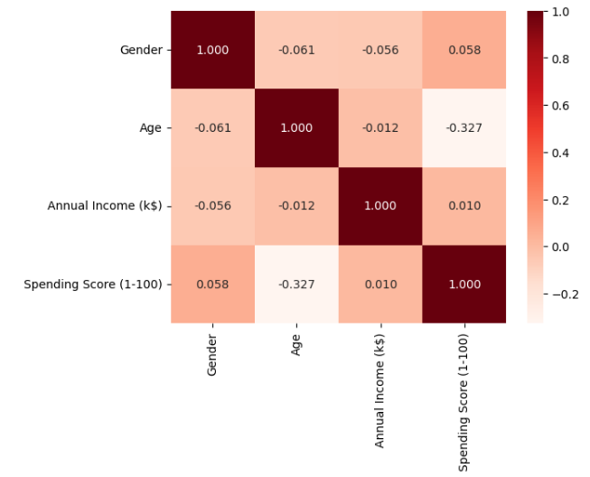
Correlation
with Spending Score
Most related:
1. Gender
2. Income

Slide 10
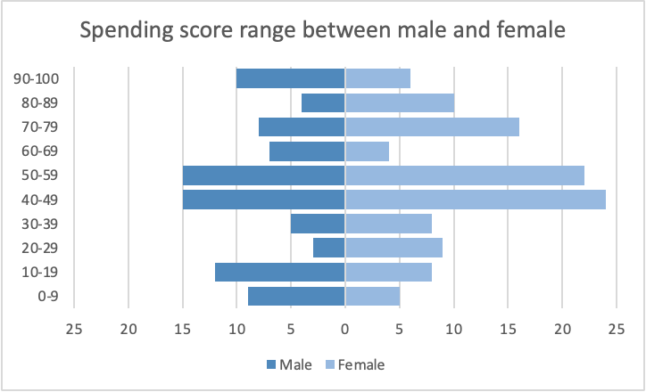
Ratio
–Spending Score & Gender
Sex ratio: 88:112 (M:F)
Highest spending score: Male

Slide 11
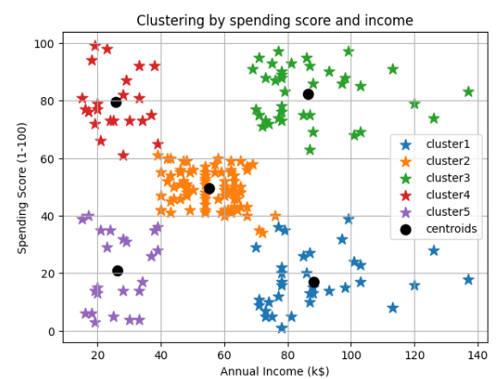
Clustering
–Spending Score & income
High spending score:
between 20 to 40 k and 70 to 100 k
annual income

Slide 12
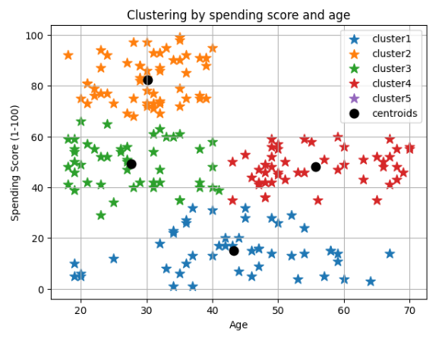
Clustering
–Spending Score & Age
High spending score: under age 40

Slide 13
Result
Optimal marketing campaign targeting
Cluster 3 and Cluster 4 in the following graph have high Spending scores, so when conducting marketing campaigns, priority is given to these two cluster layers.

Slide 14
Result
Product pricing and positioning
Divide customers into three: high spending score 60-100, middle spending score 40-60 and low spending score 0-40.
Making different marketing strategies according to different spending score.
Notes:
For high spending score groups, we will offer annual special service to maintain customer spending with same price.
For middle spending score, we can sales as pack for them.
For low spending score, we can offer some discount for them to increase the spending score.

Slide 15
Conclusion
High spending score 60-100: Offer amenities like VIP rooms to provide excellent customer service so they will keep repeat visits
Middle spending score 40-60: Provide some entertainment like live music or children activity and engage with shoppers to understand their needs and also use the activity to attract them to buy more
Low spending score 0-40: Offer exclusive discounts, promotions, or rewards to encourage more shopping
Notes:
give each clustering a specific label and title
conclusion need some action
what we need to do? what I going to use this to do anything?
three different plan like index
plan A will have how much profit?
plan B
plan C

